Slide 1
Nunit Testing in C#
Sarita Lad
DATE

Slide 2
Why is Testing Necessary?
Let's start by considering Why is Testing Necessary. Testing is essential because we all make mistakes. Some of those mistakes are not important, but some are expensive or could be life-threatening. We have to test everything that we produce because things can go wrong; humans can make mistakes at any time.
Why is Testing Necessary?
Testing's Contribution to Success
Software Testing: A Key Aspect of Quality
Human errors can cause a defect or failure at any stage of the software development life cycle. The results are classified as trivial or catastrophic, depending on the consequences of the error.
The requirement of rigorous testing and their associated documentation during the software development life cycle arises because of the below reasons:
To identify defects
To reduce flaws in the component or system
Increase the overall quality of the system

Slide 3
There can also be a requirement to perform software testing to comply with legal requirements or industry-specific standards. These standards and rules can specify what kind of techniques should we use for product development. For example, the motor, avionics, medical, and pharmaceutical industries, etc., all have standards covering the testing of the product.
The points below shows the significance of testing for a reliable and easy to use software product:
The testing is important since it discovers defects/bugs before the delivery to the client, which guarantees the quality of the software.
It makes the software more reliable and easy to use.
Thoroughly tested software ensures reliable and high-performance software operation.
Ex: Bank transaction message

Slide 4
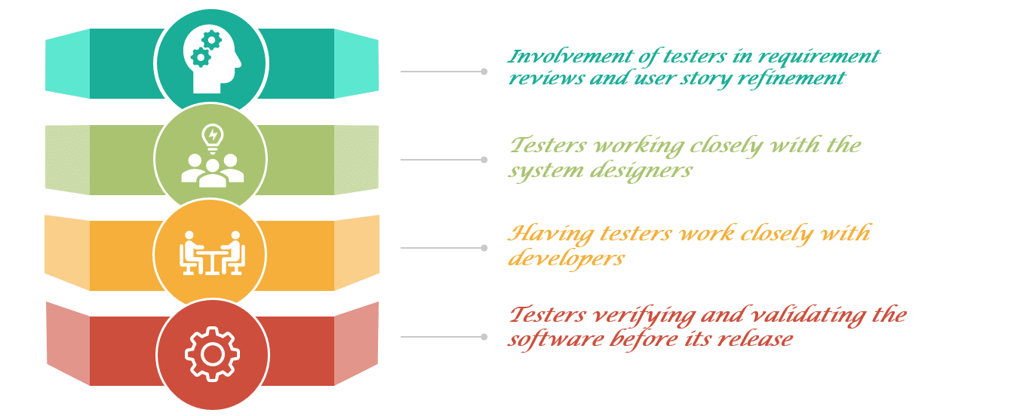
Testing's contribution to the Success
we can observe that due to the presence of defects, the system failed to perform the required operation and didn't meet the client's requirements. Appropriate testing techniques applied to each test levels, along with a proper level of test expertise, ensures an absolute reduction in the frequency of such software failures.

Slide 5
Let's have a look at how the testing can contribute to the success of the overall project:
Involvement of testers in requirement reviews and user story refinement- Involving testers during the requirement phase ensures identification of some of the requirement defects even before their implementation. It significantly reduces the fixing cost. Also, the tester gains significant project insight at this stage. Which, in turn, helps him in the execution phase of the project.
Testers working closely with the system designers- It will increase their understanding of each part of the design. Additionally, it will help in reducing the risk of fundamental design flaws and allows the identification of errors at an early stage. Moreover, it also improves the quality of integration scenarios and results in a better quality of defects.
Having testers work closely with developers- When testers work closely with developers, it enhances their understanding of each part of the code. It further enables testers to do more efficient testing against customer requirements. Thereby reducing the risk of defect slippage. Testers also become aware of areas that are considered risky by the developer so they can adjust their priorities accordingly. Additionally, developers also get the tester's insight. This helps in reproducing the bugs there and then, without going through a lengthy defect management process.

Slide 6
Testers verifying and validating the software before its release- This helps in detecting errors that otherwise may have gone unnoticed, and support the process of eliminating the defects that caused the failures. The execution of tests at various levels increases the likelihood that the software will have fewer errors and also meet the customer's needs.
Software Testing: A Key Aspect of Quality
The delivery of an optimal quality software product that has unique and innovative features has always been the priority of the software industry worldwide. However, without evaluating software components under various expected and unexpected conditions, the team cannot guarantee these aspects. Therefore, testing is performed to test every software component large and small.

Slide 7
Types of testing
1 Manual testing 2 Automated Testing
Test types
Automated tests are a great way to ensure that the application code does what its authors intend. This article covers unit tests, integration tests, and load tests
Unit tests
A unit test is a test that exercises individual software components or methods, also known as a "unit of work." Unit tests should only test code within the developer's control. They don't test infrastructure concerns. Infrastructure concerns include interacting with databases, file systems, and network resources.
For more information on creating unit tests, see Testing tools.
Integration tests
An integration test differs from a unit test in that it exercises two or more software components' ability to function together, also known as their "integration." These tests operate on a broader spectrum of the system under test, whereas unit tests focus on individual components. Often, integration tests do include infrastructure concerns.
Load tests
A load test aims to determine whether or not a system can handle a specified load. For example, the number of concurrent users using an application and the app's ability to handle interactions responsively. For more information on load testing of web applications, see ASP.NET Core load/stress testing.

Slide 8
Testing tools
.NET is a multi-language development platform, and you can write various test types for C#, F#, and Visual Basic. For each of these languages, you can choose between several test frameworks.
xUnit
Nunit
MS Test
.Net CLI
Why should I do Unit testing?
Unit testing ensures that all code meets quality standards before it's deployed. This ensures a reliable engineering environment where quality is paramount. Over the course of the product development life cycle, unit testing saves time and money, and helps developers write better code, more efficiently.

Slide 9
What is Unit Testing?
A unit is the smallest part that tests in software. Generally, it has a few inputs and one output. Unit testing is a software testing process in which small test components of an application or software, called units, are processed individually for better performance. This testing methodology is done during the development process by the software development process developers
Unit testing involves testing individual components of a software program or application. The main objective of this process is to check that all the individual units are working in an intended way. Unit testing is a vital step in the development process, as if done correctly, it can help detect initial code errors that may be more difficult to find in recent test stages.
Unit testing is part of a test-driven development (TDD) and is a process that takes a careful approach to building a product through continuous testing and review. This testing method is the first level of software testing. Unit tests often break down to ensure the unit is not dependent on any external code or functions.

Slide 10
NUnit Testing Framework
NUnit is a unit-testing framework for .NET applications in which the entire application is isolated into diverse modules. Each module is tested independently to ensure that the objective is met. The NUnit Framework caters to a range of attributes that are used during unit tests. They are used to define Test -Fixtures, Test methods, ExpectedException, and Ignore methods.
TestFixture Attribute
The TestFixture attribute is an indication that a class contains test methods. When you mention this attribute to a class in your project, the Test Runner application will scan it for test methods.
Test Attribute
public class Program {
[Test]
public void Test() { ...
}
}

Slide 11
Assert Class
the Assert class is used to confirm whether the test cases are producing the expected result or not using its auxiliary methods such as AreEqual() or AreNotEqual().
This is the way to specify that the execution of a test will throw an exception. This attribute takes a parameter which is a Type. The runner will execute the test and if it throws the specific exception, then the test passes. If it throws a different exception the test will fail. This is true even if the thrown exception inherits from the expected exception.
ExpectedException Attribute
You could fortify your code to handle various exceptions by using try...Catch blocks. But sometimes you have some circumstances where you actually want to ensure that an exception occurs. To overcome such a problem you should use the ExpectedException attribute as in the following
[TestFixture]
public class Program {
[Test]
[ExpectedException(typeof(DivideByZeroException))]
public void Test() {
int i = 10, j = 0, x;
x = i / j;
}
}

Slide 12
we write our first NUnit test case example method code. A test case body is divided into three sections "AAA".
"AAA" denotes the Arrange, Act, and Assert.
Arrange: In Arrange section, we will initialize everything which we are required to run the test case. It includes any dependencies and data needed.
Act: In Act section, we call the business logic method which behavior we want to test.
Assert: Specify the criteria for passing the test case. If these criteria passed, that means test case is passed else failed.

Slide 13
Assertions- Constraint Model
The constraint-based Assert model uses a single method of the Assert class for all assertions. The logic necessary to carry out each assertion is embedded in the constraint object passed as the second parameter to that method.
Assert.That(28, Is.EqualTo(_actualFuel)); // Tests whether the specified values are equal.
Assert.That(28, Is.Not.EqualTo(_actualFuel)); // Tests whether the specified values are unequal. Same as AreEqual for numeric values.
Assert.That(_expectedRocket, Is.SameAs(_actualRocket)); // Tests whether the specified objects both refer to the same object
Assert.That(_expectedRocket, Is.Not.SameAs(_actualRocket)); // Tests whether the specified objects refer to different objects
Assert.That(_isThereEnoughFuel, Is.True); // Tests whether the specified condition is true

Slide 14
Why MOQ used in NUNIT testing
If the method returns true the test will be passed. The advantages of using Moq is, we can unit test the code successfully without using an external dependency object in the test code. Conclusion: NUnit and Moq are the suitable frameworks for testing the MVC Model layer.
we create a testing library, add the references to NUnit and Moq frameworks, and add the tester class CalculatorTester to define the test cases.
Moq is very easy to use mocking framework. In order to define the mock objects, we use generics passing the interface as the type. The behavior of the mock objects is done using basically a set of lambda expressions, making the code more productive and type safe

Slide 15
Thank You

